Slide 1
Introduction to Data Warehousing

Slide 2
The Problem
lots of data … but very little information
most databases are designed to support operational, or transaction, processing
informational processing – analysis of data to support decision making – is quite different from operational processing and is not well-supported by operational databases

Slide 3
Business Intelligence
to address this problem business intelligence (BI) tools have been developed to gather and analyze the data needed to support decision making
BI is a framework, not a specific tool

Slide 4
Steps in BI
BI involves
collecting data from operational databases and other sources
aggregating the data, where necessary
analyzing the data
making decisions based on the data analysis
monitoring results of the business decisions (and collecting more data on the results)

Slide 5
Components of BI Architecture
ETL (extract, transform, load) tools to extract data from operational databases and other external sources, transform the data when necessary, and load the data into a data store
Data store: typically, a data mart or data warehouse optimized for decision support

Slide 6
Components of BI Architecture
query and analysis tools: typically, an OLAP (online analytical processing) tool to retrieve and analyze data in the data store
data visualization tools: tools to present the data to the user in a meaningful (frequently graphical) way

Slide 7
Data Warehouse
we will focus on the ETL process and the data store (data mart or data warehouse)
what is a data warehouse?
a subject-oriented, integrated, time-variant, non-updatable collection of data used in support of management decision-making processes
Notes:
page 438

Slide 8
And What Does THAT Mean?
subject-oriented: e.g. customers, patients, students, products
integrated: consistent naming conventions, formats, encoding structures; from multiple data sources
time-variant: can study trends and changes
nonupdatable: read-only, periodically refreshed
Notes:
page 438

Slide 9
Operational Databases
the “ordinary” databases that are used for daily operations are called operational databases
an operational database is transaction-oriented
many transactions are executed each day
each transaction may refer to only one or a few rows

Slide 10
Data Warehouses
a data warehouse is designed for decision support
queries are broad and complex in nature
a query may require many rows (thousands) of data for processing

Slide 11
Transient Vs. Periodic Data
most operational systems use transient data in which existing records are over-written with new data
most data warehouses use periodic data that are never physically altered or deleted once they are added to the data store
periodic data normally include a timestamp

Slide 12
Operational Vs. Data Warehouse Data
Operational Data | Data Warehouse Data
Transient – not historical | Periodic – allows for historical trends to be studied
Normalized to 3NF – may be lightly denormalized for performance | Not fully normalized
Restricted in scope – not comprehensive | Of wide scope – may draw from several different data sources
Sometimes of poor quality – inconsistencies and errors are frequently present | Of good quality, with most inconsistencies and errors removed

Slide 13
Data Marts
a data mart is a data warehouse that is limited in scope
a data warehouse may be constructed by building individual data marts, and then combining the data marts, if consistent design models are used
we will look primarily at data marts to learn concepts generally applicable to data warehouses

Slide 14
Building a Data Warehouse
data warehouses are built from operational databases using a set of processes known as extraction-transformation-load (ETL)
extracting data from the source systems
transforming data to the format required for the data warehouse system
loading data into the data warehouse

Slide 15
Reconciled Data
after ETL, data should be:
as detailed (not summarized) as feasible -- this provides maximum flexibility for a wide variety of users
historical – periodic
comprehensive – enterprise-wide perspective
quality controlled – accurate with full integrity

Slide 16
The ETL Process
extract – typically, a snapshot of the data at a particular point in time is “captured” in preparation for moving to the data store
transform – errors are corrected, missing data is identified if possible, and consistent formats and names are implemented
load – data is loaded into the warehouse and indexed for fast retrieval

Slide 17
Frequency of Updates
the data warehouse should be updated as frequently as is practical
some applications require near-real-time loads and updates
for many applications, updating once a day is sufficient
Wal-Mart updates continuously using massively parallel data warehouse technology

Slide 18
Date Warehouse Design
data warehouse design commonly uses the dimensional model
also referred to as a star schema

Slide 19
The Dimensional Model
the dimensional model is a denormalized implementation of the relational data model
it consists of fact tables and dimension tables

Slide 20
Fact Tables
a fact table contains factual or quantitative data about a business unit, such as units sold, orders booked, and so forth
fact tables are usually 3NF

Slide 21
Dimension Tables
a dimension table contains descriptive data about the subjects of the business
typical dimensions (subjects) are Product, Customer, and Period (or Date)
dimension tables are usually denormalized
the simplest star schema consists of a single fact table, surrounded by several dimension tables

Slide 22
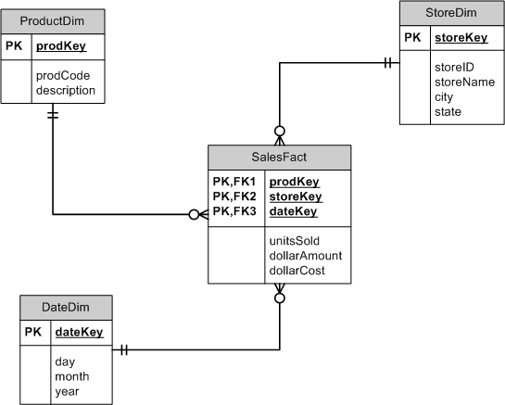
A Sample Star Schema

Slide 23
Sample Star Schema Data
storeKey | storeID | storeName | city | state
001 | HV123 | HyVee | Maryville | Missouri
002 | WF987 | WholeFoods | Overland Park | Kansas
prodKey | prodCode | description
A123 | DM001 | Del Monte Green Beans
B111 | K032 | Kraft Shredded 2% Cheddar Cheese
C456 | GV789 | Great Value Green Olives
A111 | S005 | Smucker’s Crunchy Peanut Butter
dateKey | day | month | year
32 | 1 | 2 | 2008
33 | 2 | 2 | 2008
34 | 3 | 2 | 2008
35 | 4 | 2 | 2008
prodKey | storeKey | dateKey | unitsSold | dollarAmount | dollarCost
A123 | 001 | 32 | 75 | 75.00 | 37.50
A123 | 001 | 33 | 85 | 83.00 | 42.50
A111 | 002 | 32 | 50 | 75.00 | 50.00
… | … | … | … | … | …

Slide 24
Primary Key – Dimension Tables
primary keys for dimension tables should be simple, surrogate keys
if a dimension table corresponds to an operational table with a primary key, the original primary key should be stored as an attribute in the dimension table
do not use the primary key from the operational table as the primary key in the data warehouse table; use a new surrogate key instead

Slide 25
Primary Key – Fact Table
fact tables will have a composite key made up of the primary keys of the dimension tables, each of which will be a foreign key into the respective dimension table

Slide 26
Grain of Fact Table
the grain of a fact table is the level of detail in the table as determined by the intersection of all the components of the primary key
determining the appropriate grain is critical: data can always be summarized, but a data warehouse cannot access data at a finer grain than the grain of the fact table

Slide 27
Determining Granularity
finest grain possible is the transactional grain
a transactional grain allows for market basket analysis -- the study of buying habits of individual customers
storing summarized data (sales total per day per product, for example) yields an aggregated grain

Slide 28
Introduction to Data Warehousing
The End

